Slide 1

Trust Management
In Edge Computing

Slide 2
Problems in Edge Computing
Latency
Network band width
Security and privacy
Control and management
Data accumulation

Slide 3
Security and Privacy in Edge Computing
Physical tempering and Attacks
DDoS Attacks
Trust Management
Privacy Enhancing in cryptographic in edge computing
Security of crowd sourcing

Slide 4
Introduction

Slide 5
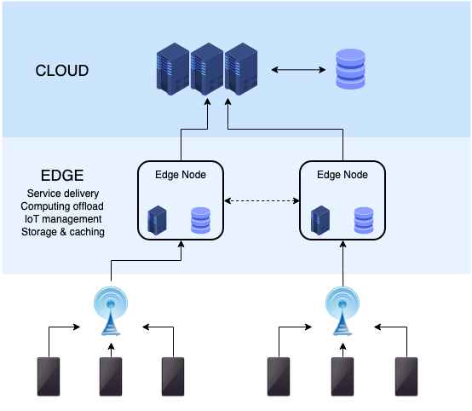
What is edge Computing
Edge computing is a distributed computing paradigm that brings computation and data storage closer to the location where it is needed to improve response times and save bandwidth

Slide 6
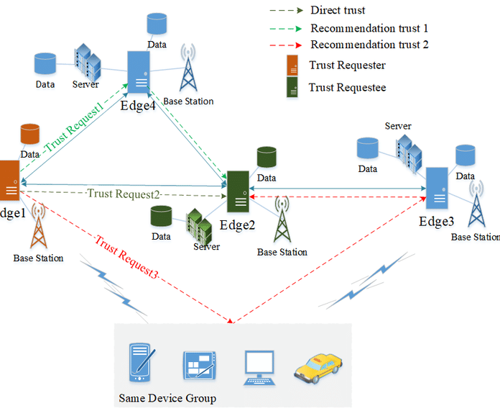
Trust management in edge computing

Slide 7
Trust Management
Trust management is a system for computing
assures secure data access through trustworthy cloud service
reduce malicious or bad nodes.

Slide 8
Problem Statement
Our problem is to reduce malicious or bad nodes using different mechanisms based on trust management in order make our system more secure, reliable and speedy

Slide 9
Literature Review

Slide 10
1.Multi-layer trust fusion mechanism based on time decay for edge computing
Problem
Malicious nodes which produce an error.
Error affects the feedback of node
Feedback provided by the node will affect the result

Slide 11
Trust Management for the calculation.
Trust evaluation mechanism to evaluate the collaborative work.
Certain degree of improvement in computational efficiency
Interaction success rate over other existing models
Reduces the situation of malicious node deception.
Solution

Slide 12
IoT Edge Computing Trust Management Mechanism for Smart Cities

Slide 13
IoT Edge Computing Trust Management Mechanism for Smart Cities
Smart cities use IoT devices
Ability to remotely monitor, manage and control devices
Users participate in smart city through intelligent mobile devices
(such as personal wearable devices, smartphones or sensors)
Street lights management
Traffic management
Smart Home management

Slide 14
IoT Edge Computing Trust Management Mechanism for Smart Cities
IoT edge computing systems are subject to many malicious attacks and security risks.
Some intelligent devices of IoT may maliciously damage the network or services.
Main challenge in device sensing layer is to select trusted participants.
Proposed a dynamic black-and-white list device selection recommendation mechanism.

Slide 15
Trust Management in edge computing using Block chains

Slide 16
Block chains
Tamper resident digital ledgers
Implemented in distributed manner
Decentralized system
No central authority

Slide 17
Categories of Block Chain
Permission less Block Chain
no validation
Everyone has access to network
ledgers can replicate the transactions.
Permissioned Block Chain
Formed by a set of transacting parties
Data access provided through validation
validation is controlled by a set of selected nodes.

Slide 18
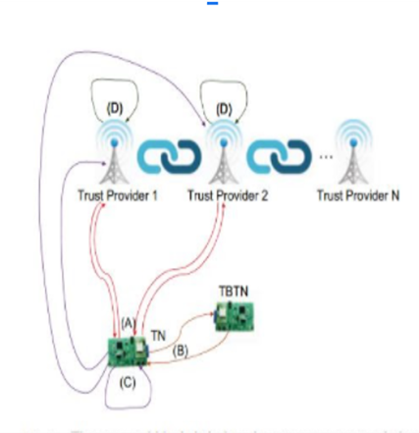
•Permissioned Block Chain
•Blocks are created by edge nodes
•IOT devices request edge nodes for trust degrees of TBTN
•Store wallets of trust evaluation of nodes
•Communication b/w TN and TBTN is a transaction
•Validation of blocks for trust comparisons of interactions
•Secured and reliable fetch of trust degrees

Slide 19
Results and Analysis

Slide 20
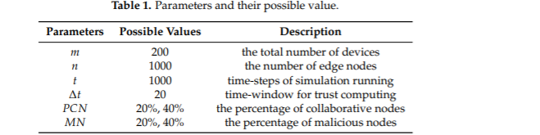
Multi Fusion Technique
Accuracy up to 60 to 80 %
20% malicious nodes found

Slide 21
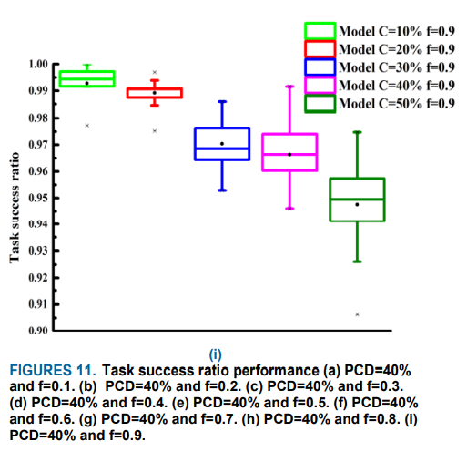
IOT Trust Mechanism
40% accuracy achieved

Slide 22
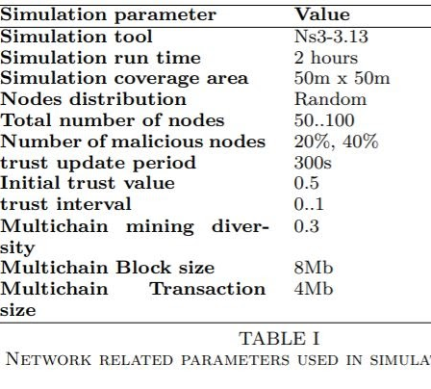
Block Chain based trust management
Accuracy 60 %to 80% achieved

Slide 23
Comparison
 | accuracy
Blockchain | 60% to 80%
Multi fusion | 60% to 80%
Iot | 40%
Block chain and Multi Fusion Mechanism are secured

Slide 24
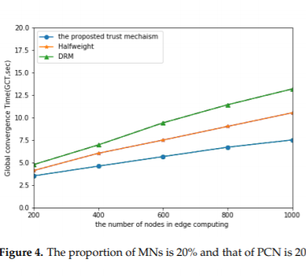
Efficiency of Multi Fusion Mechanism
Algorithms require high processing power
Costly method

Slide 25
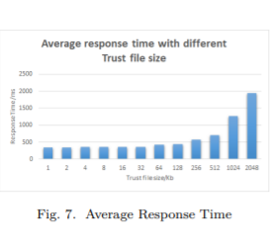
Block Chain based Trust Mechanism
Less processing power
About 8 GB Ram
Cost effective

Slide 26
Block Chain based trust Mechanism
security
reliability
efficiency

Slide 27
Recommendation
Edge computing is not limited to certain companies
It will become an infrastructure like 5G
As Edge computing is becoming popular, security risks are increasing day by day
Trust Management still needs much research as it is an emerging technology
Companies should start working on improving Trust Management Mechanisms
There are Many different methods and means to build the Trust model
Necessary to standardize it to improve the universality of the model

Slide 28
Conclusion
Maintenance of trust management is now a challenge for organizations.
Different types of organizations try to overcome this problem with high accuracy.
Analysis of this research tells us that block chain is a better approach.
Block chain provides high accuracy, security , speed at low cost.

Slide 29
Thank you!
Hizafa Nadeem L18 -1105
Hammad Abdullah L18 -1085
M. Hassan Mahmood L18 -2194

